Slide 1

Gas-Theft Suspect Detection among Boiler Room Users: A Data-Driven Approach
IEEE Transactions on Knowledge and Data Engineering, 2021
(CCF A)

Slide 2
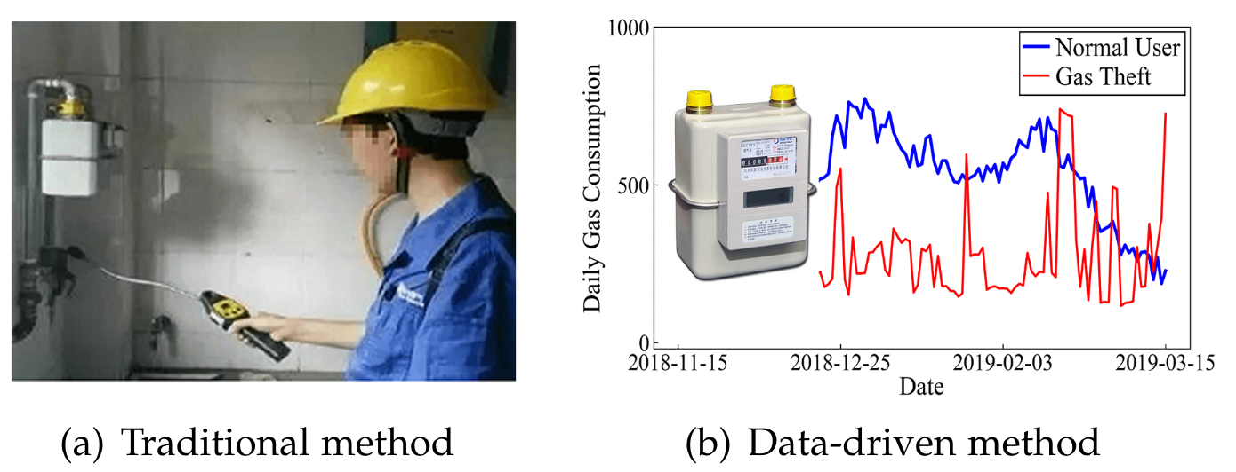
Introduction
Background：
Driven by gray incomes, some users are prone to stealing gas by refitting the equipment without permission.
Contributions：
The first data-driven approach to detect gas-theft suspects of boiler rooms
The authors propose a deformation-based normality detection algorithm to detect normal and abnormal users
Based on the separated normal and abnormal users, the authors propose an OCSVM based anomaly detection algorithm to capture multiple characteristic factors for identifying gas-theft suspects.
The authors conduct experiments on a real-world dataset over one heating season

Slide 3
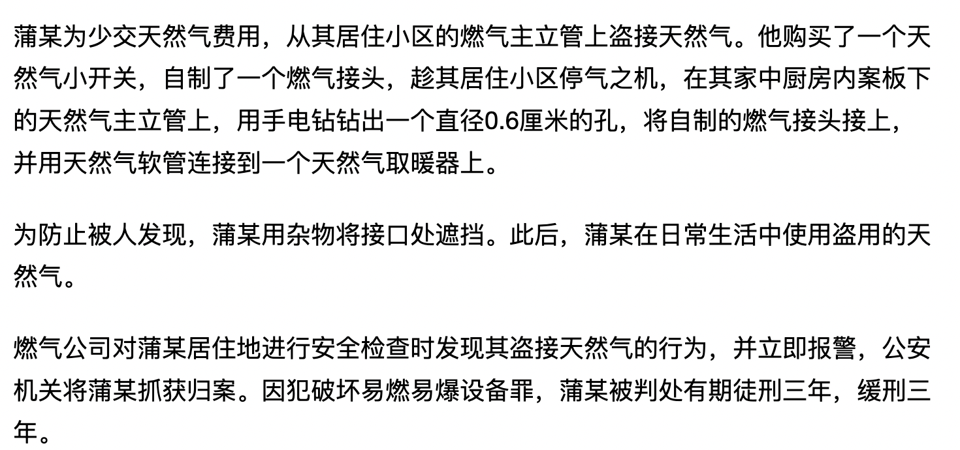
Introduction

Slide 4
Related Work
Time series anomaly detection
Similarity-based approaches
Euclidean distances
Pearson correlation
model-based approaches
learn a hyper-plane for splitting the anomalies
OCSVM
VAE
Donut
DAGMM
classification problem
SRCNN
The author combine the 2 type approaches

Slide 5
Related Work
Utility Fraud Detection
hardware solutions
protecting meters
non-hardware solutions
classification-based techniques
clustering-based methods
No fully labeled data, No rules of minor clusters or outliers. They authors first detect normal boiler rooms, then extract features.

Slide 6
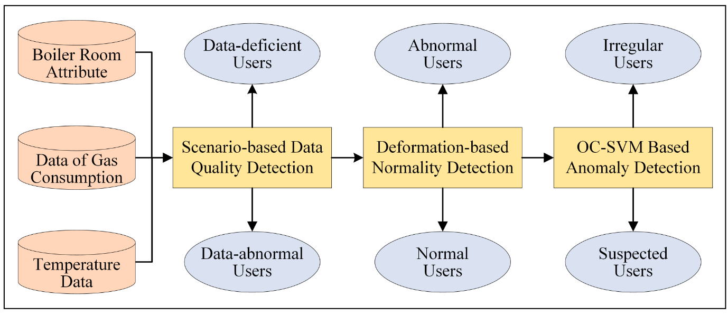
Methodology

Slide 7
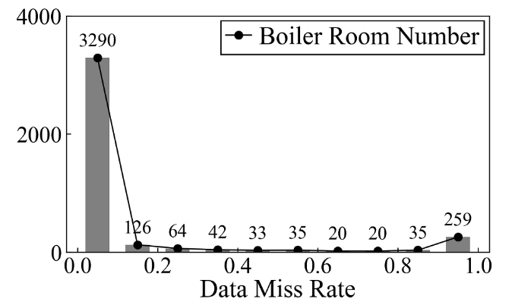
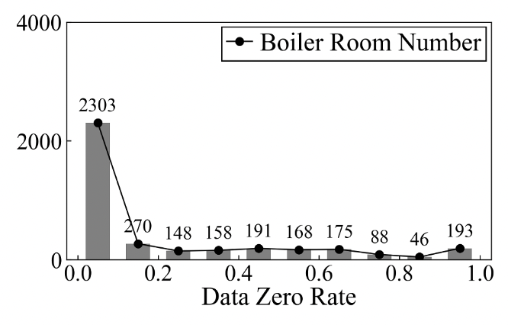
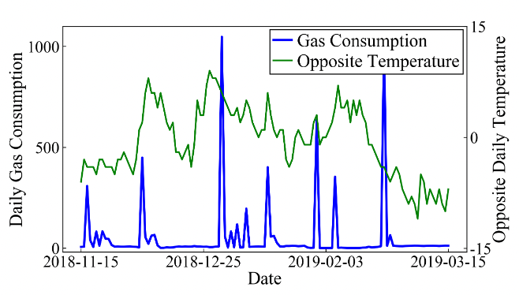
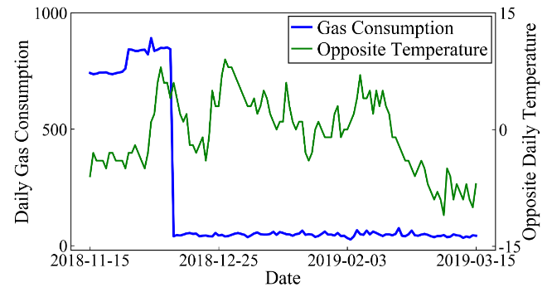
Methodology Scenario-based Data Quality Detection
First, exclude users whose data miss rate is higher than 10%.
Second, exclude users whose data zero rate is higher than 70%.
Third, exclude users whose maximum daily gas consumption is ten times greater than the median
Forth, exclude users whose daily gas consumption is lower than half of the maximum for more than 7 days (one week)

Slide 8
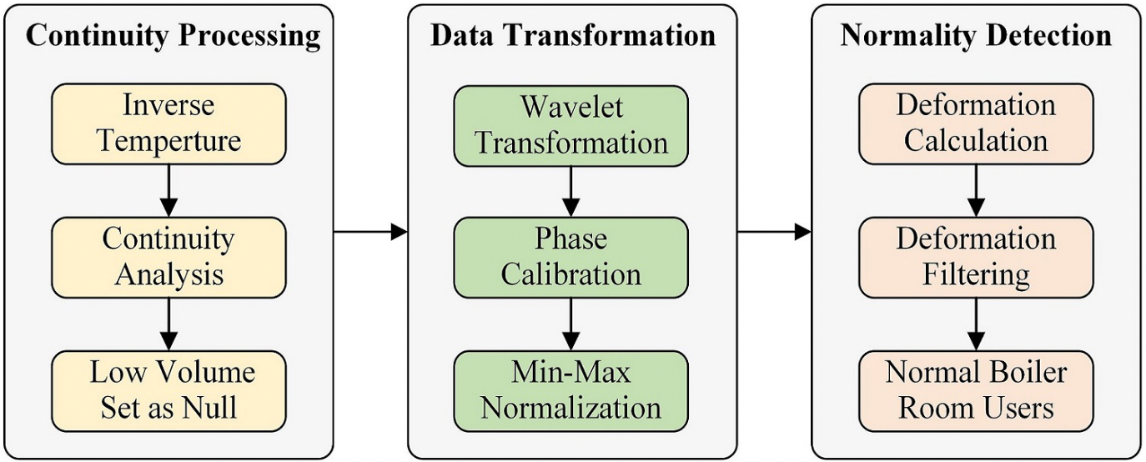
Methodology Deformation-based Normality Detection

Slide 9
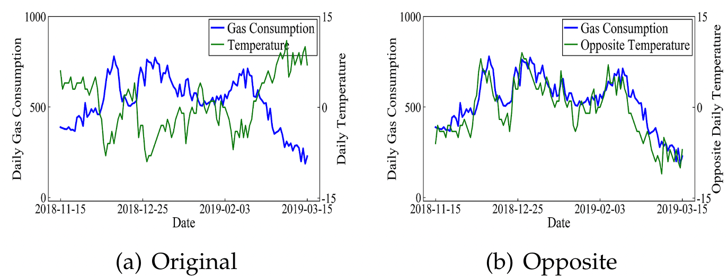
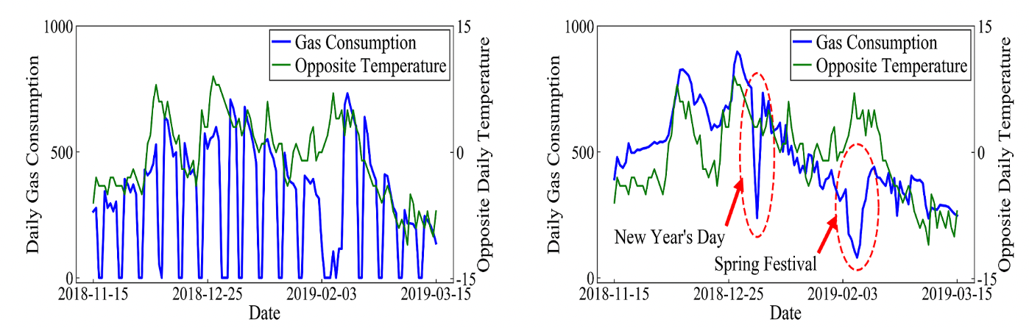
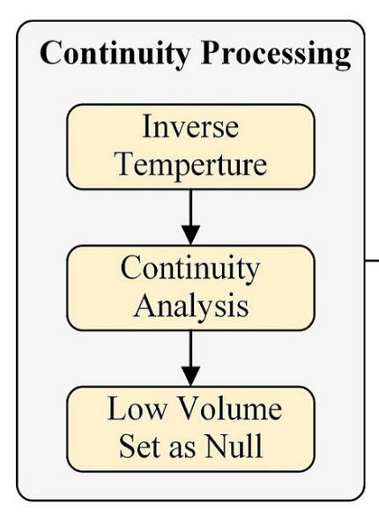
Methodology Deformation-based Normality Detection

Slide 10
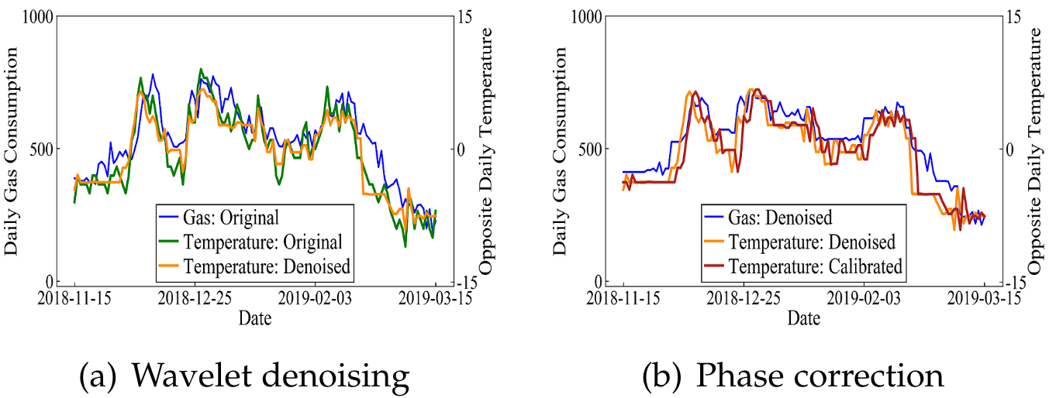
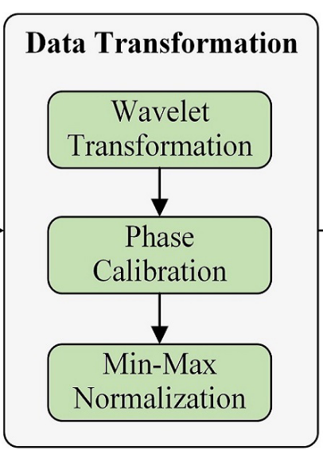
Methodology Deformation-based Normality Detection
Haar wavelet

Slide 11
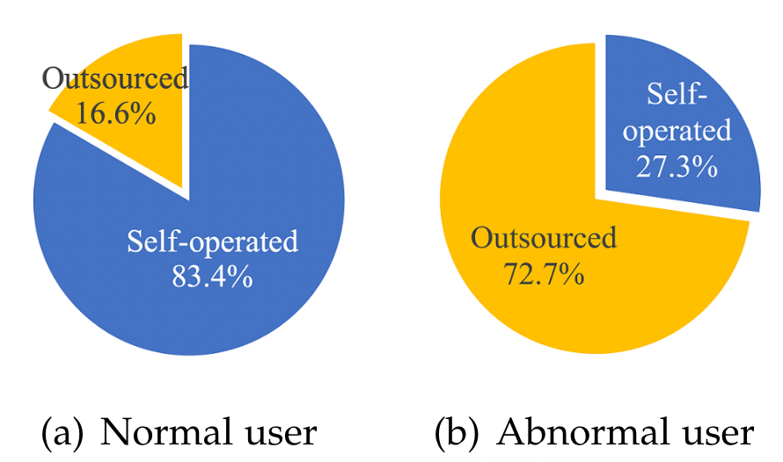
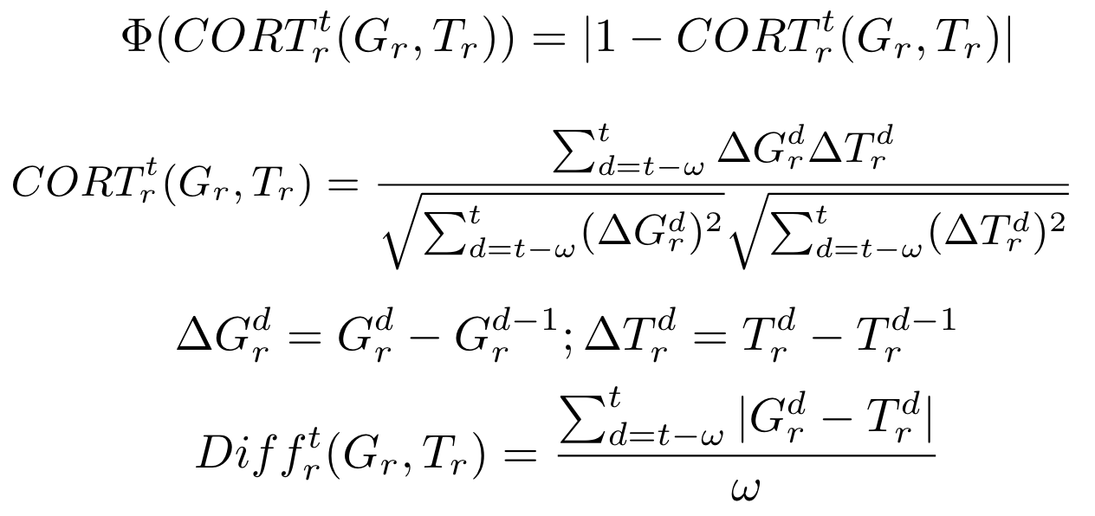
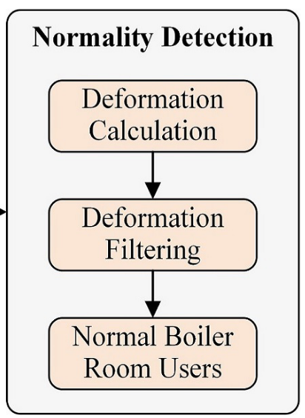
Methodology Deformation-based Normality Detection
Using ShaperVar, Set a threshold to judge whether a boiler room is normal or not.

Slide 12
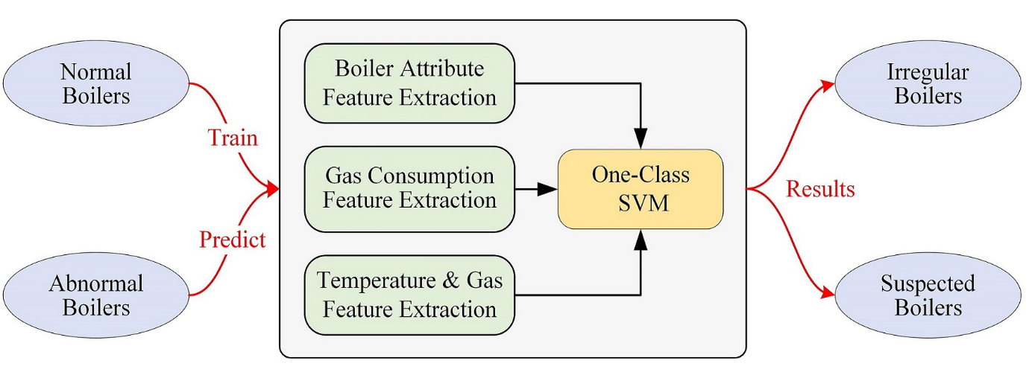
Methodology OCSVM-based Anomaly Detection

Slide 13
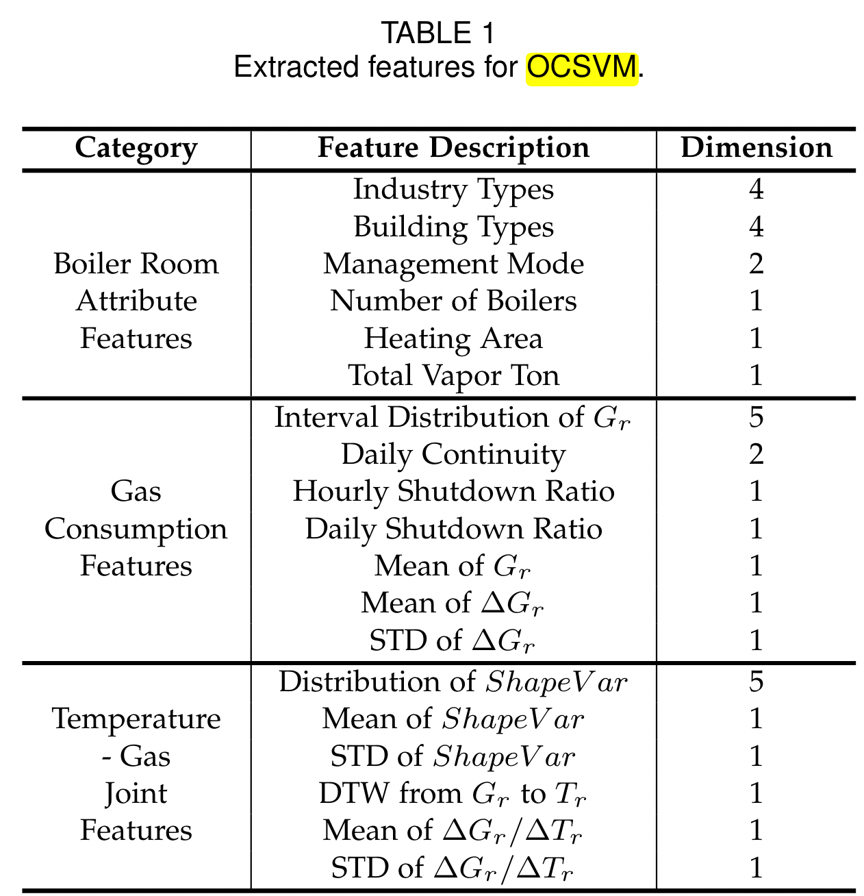
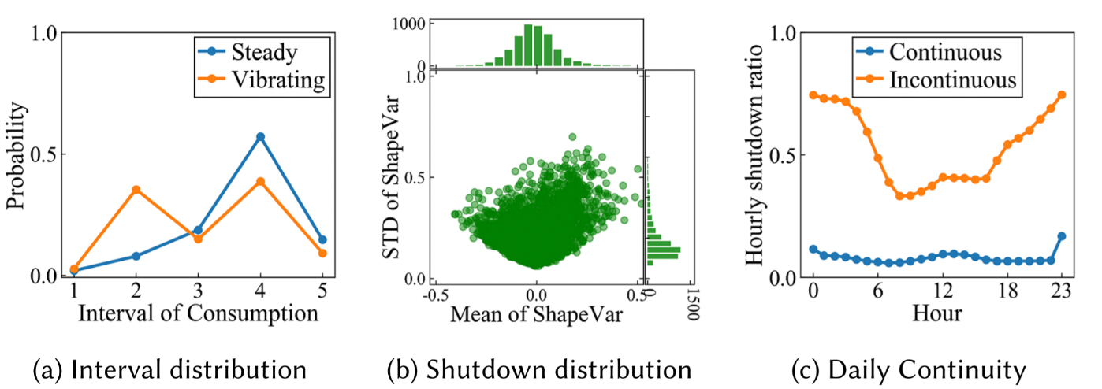
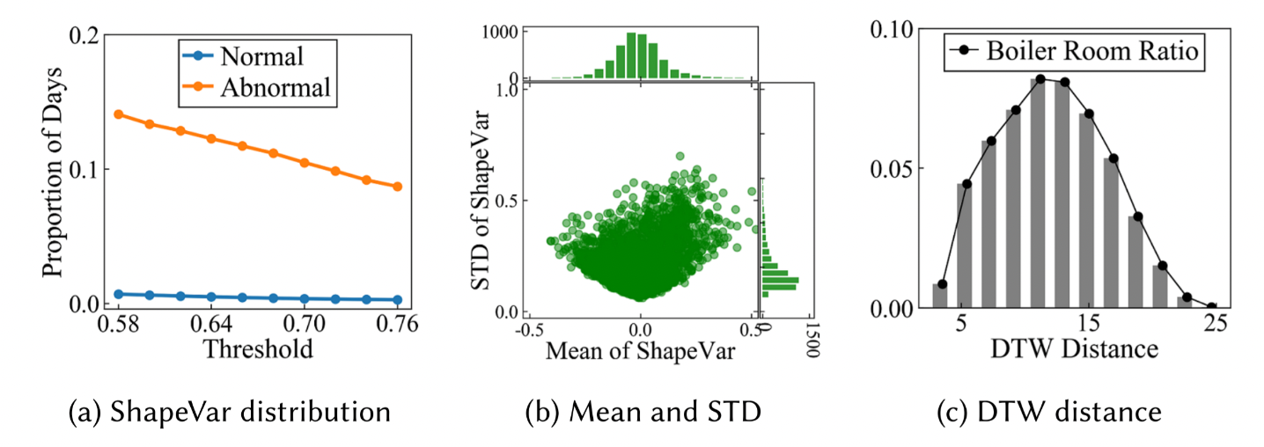
Methodology OCSVM-based Anomaly Detection

Slide 14
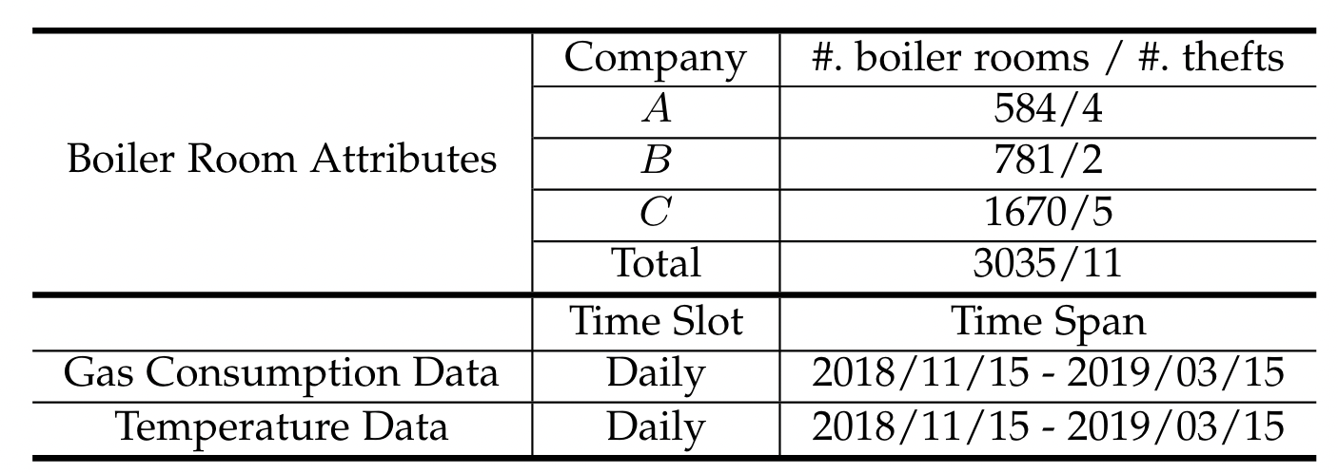
Dataset

Slide 15
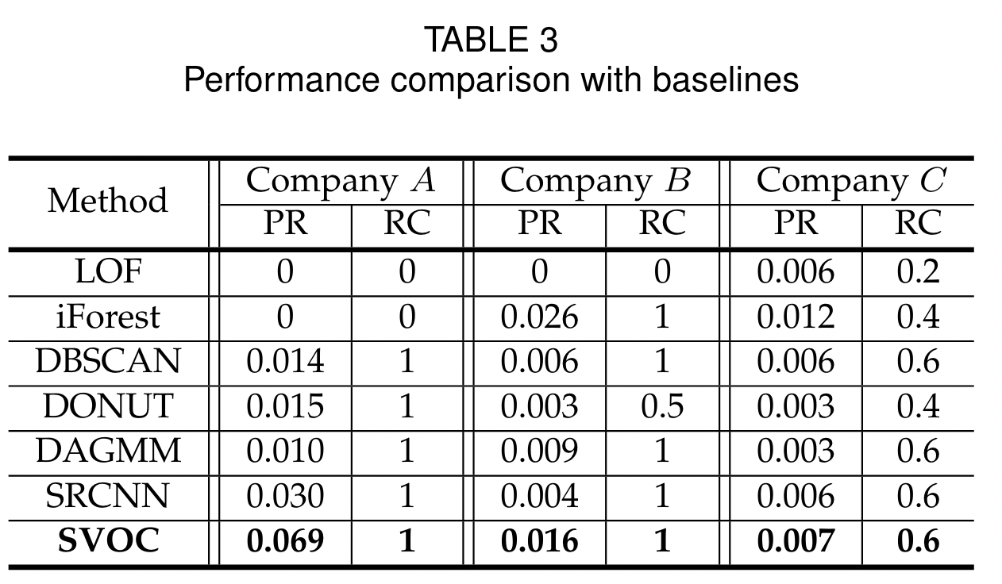
Evaluation

Slide 16
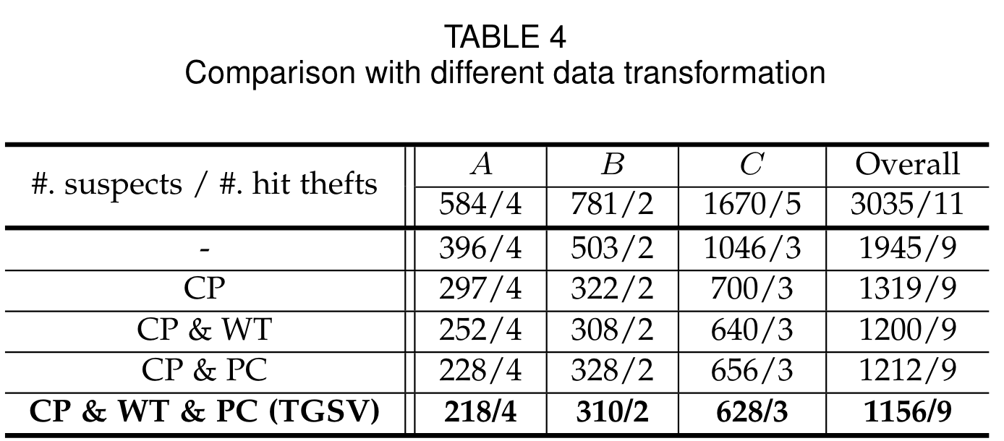
Evaluation

Slide 17
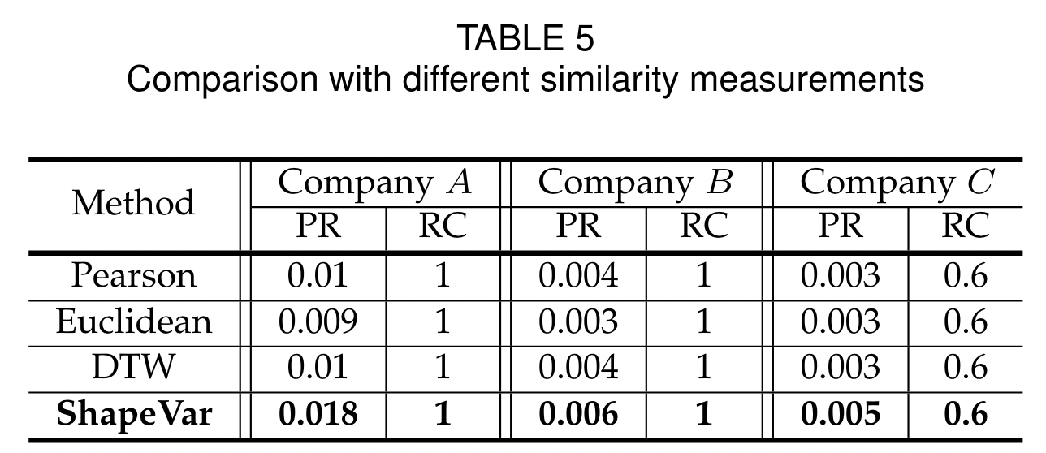
Evaluation

Slide 18
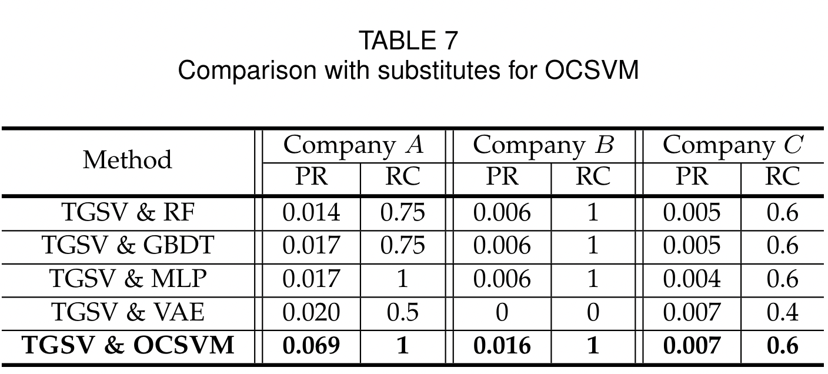
Evaluation

